Slide 1

Aleena Zainab | 181081
Rameen Shakeel | 181137
FYP Semester: | III
FYP-ID: | CS-SP-21-23
Date: | 17-05-2022
Image Annotation Tool
Supervisor: | Dr. Anabia Sohail
Examiner: Sir Atif Muqarrab
Moderator: Sir Saud Arshad

Slide 2
Table of Contents
Enter your project title here
Introduction & Literature Review
Problem Statement
System Features & Requirements
User Interface & Use Cases
Software Diagrams (Class, Sequence, etc)
Tools & Technologies
Conclusion
Video Demo
References

Slide 3
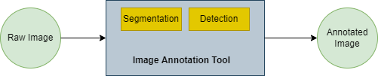
Introduction
Enter your project title here
“Image Annotation is the process of labeling or classifying an image using annotation tool, to show data features. When you annotate an image, you are adding metadata to a dataset.”

Slide 4
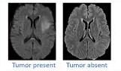
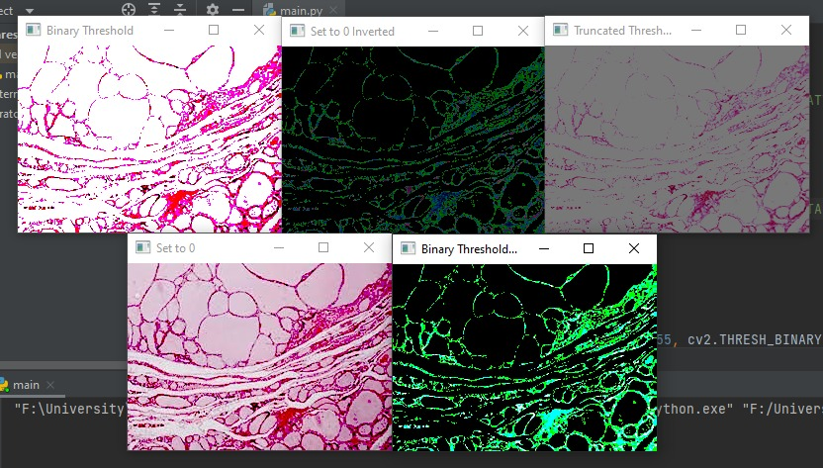
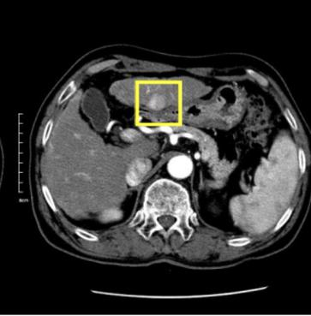
Cont.
Classification
Segmentation
Detection

Slide 5
Literature Review / Existing Solutions
Enter your project title here
Most of the tools for labelling medical imaging datasets are either for commercial use or have high priced subscriptions. In our work, we aimed to design an open source simple and easy to use tool for medical use to perform annotations with minimum training.
Visual Geometry Group developed a web-based tool(VGG Image Annotator).This tool provides the segment annotation option for audios and video along with drawing of objects shapes in images.
Slide Runner is developed for annotations. This tool targets giga pixel images but does not accommodate small image patches.

Slide 6
Cont.
Enter your project title here
Visual Object Tagging tool (VoTT) is also an open source annotation and labelling tool for videos and images.
Computer vision annotation tool (CVAT) is an open source, web-based annotation tool with support for both images and videos. It is a browser based application and only works with Google Chrome browser.
Label studio is a web-based, open source labelling and annotation tool. This tool is simple yet powerful along with the support for multiple bounding box shapes.

Slide 7
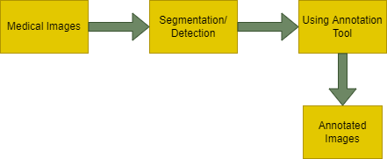
Problem Statement
Enter your project title here
Large amount of medical data enables the utilization of computer vision, deep learning, and other pattern recognition methods in designing automated diagnostic systems. Two main problems that persist in the field of computational pathology, are:
the inception of raw data in large amount
the labeling or rather agreed upon labeling of data

Slide 8
System Features & Modules
Enter your project title here
System’s main features is to apply segmentation and detection techniques on medical images.
Segmentation Feature
This is the feature of segmentation in which different segmentation techniques can be applied.
Binary Thresholding
Adaptive Thresholding
Otsu Thresholding

Slide 9
Cont.
Enter your project title here
Detection Feature
This is the feature of detection in which:
A bounding box/square will be generated on uploaded image
The annotated image will be downloaded.

Slide 10
Requirement Analysis
Enter your project title here
Functional Requirements
User must be able to login into the system otherwise signup and upload single or multiple images for annotation.
The system must allow the user to view, to modify only his/her annotations.
The administrator must be able to view and modify all annotations of all users.
System takes an image in order to give result. Images can be in .jpeg, .png or any other format.
System shows the segmented image and create the bounding boxes to the user on web-based application’s UI
Algorithms: Otsu thresholding, Adaptive thresholding, Binary thresholding, Detection.
For Image segmentation Unet Model has been trained.

Slide 11
Cont.
Non-Functional Requirements
Performance
Safety
Security
Reliability
Portability
Efficiency
Maintainability

Slide 12
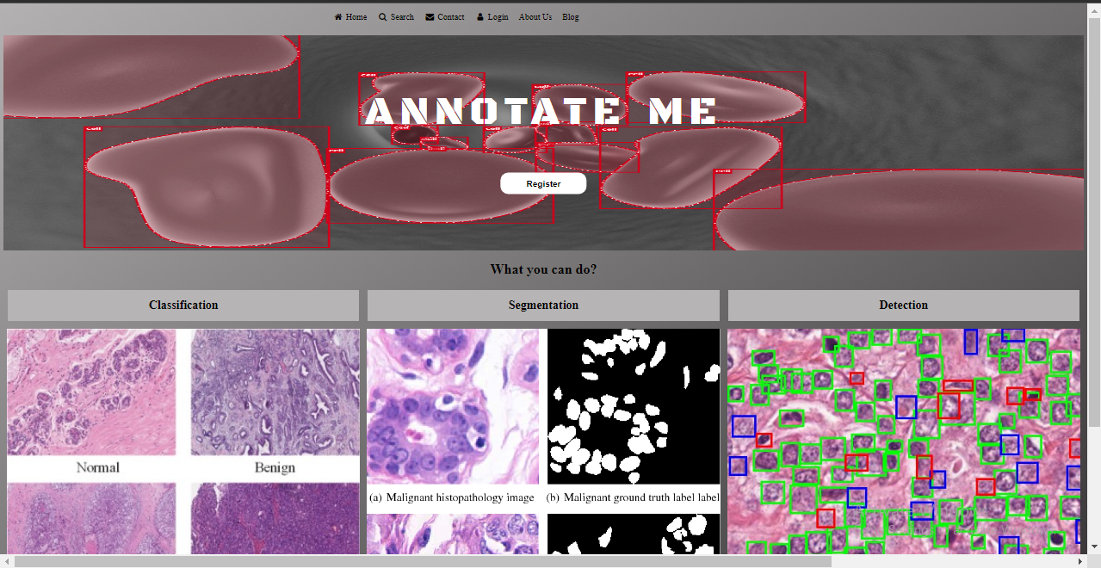
User interface & Visual Design of Product
Enter your project title here

Slide 13
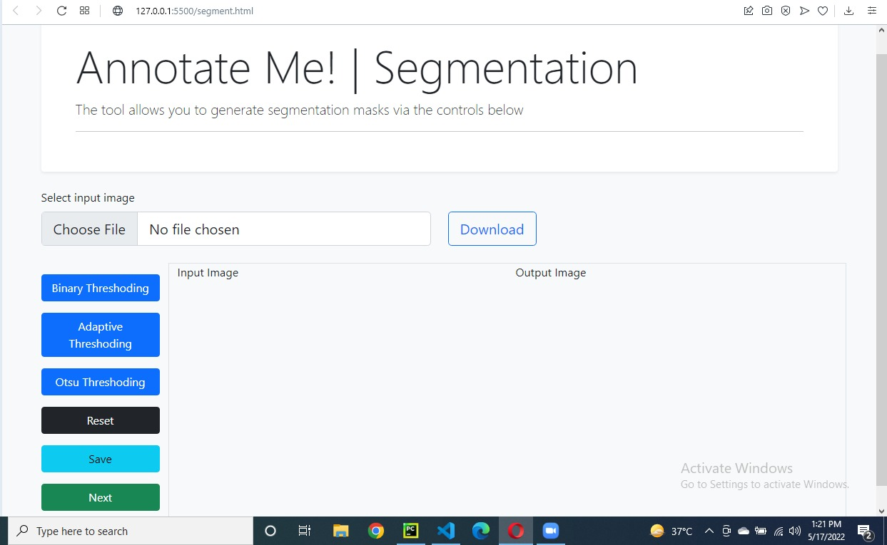
Cont.
Enter your project title here

Slide 14
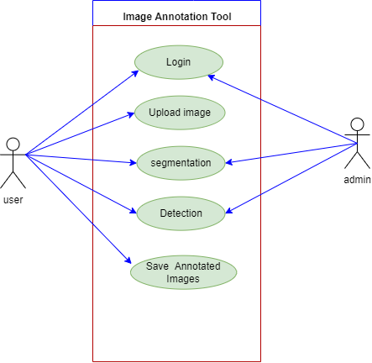
Use Case Diagram
Enter your project title here
Fig 1: Use case diagram

Slide 15
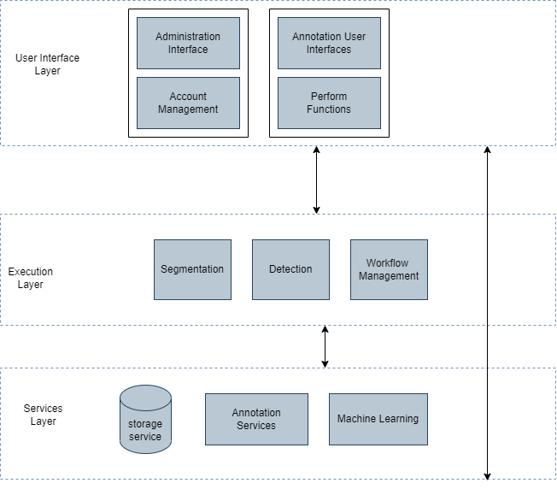
Architecture Diagram
Enter your project title here

Slide 16
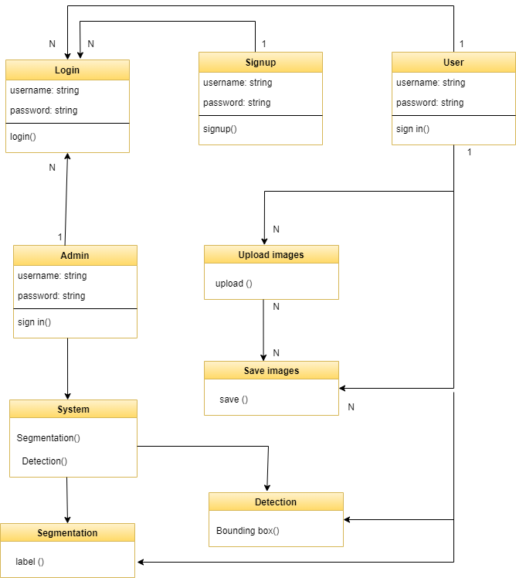
Class diagram
Enter your project title here

Slide 17
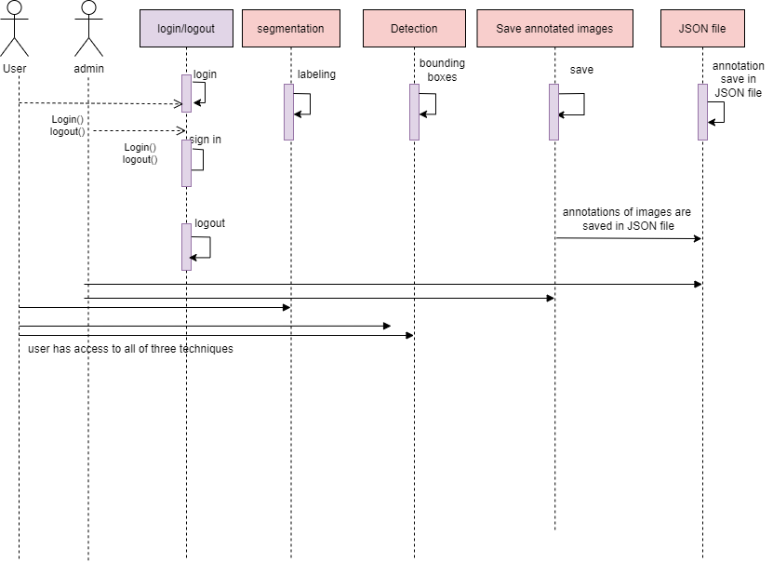
Sequence diagram
Enter your project title here

Slide 18
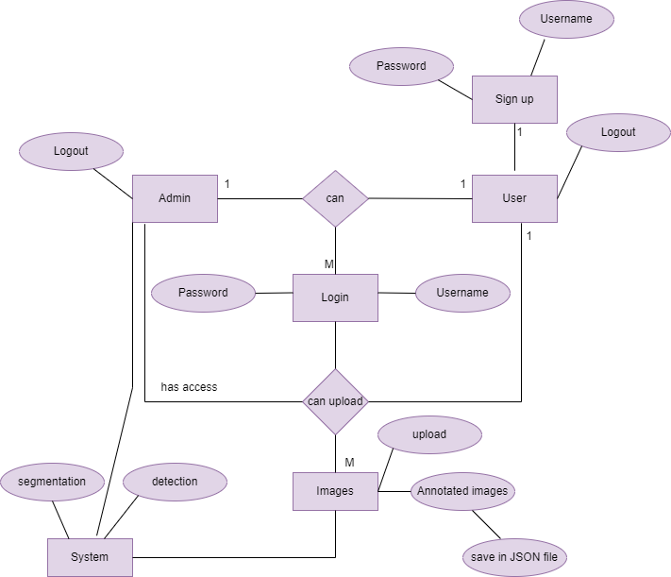
Entity Relationship diagram
Enter your project title here

Slide 19
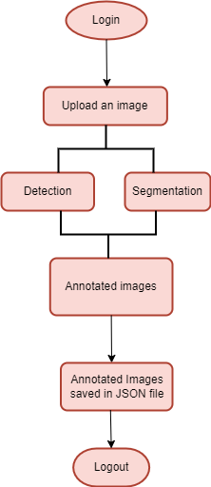
Flow Diagram
Enter your project title here
Fig 2: Flow diagram

Slide 20
Tools and Technologies
Enter your project title here
Tools:
Visual Studio Code
PyCharm
Google colab
Technologies:
Python
Flask
Canvas
Image processing techniques

Slide 21
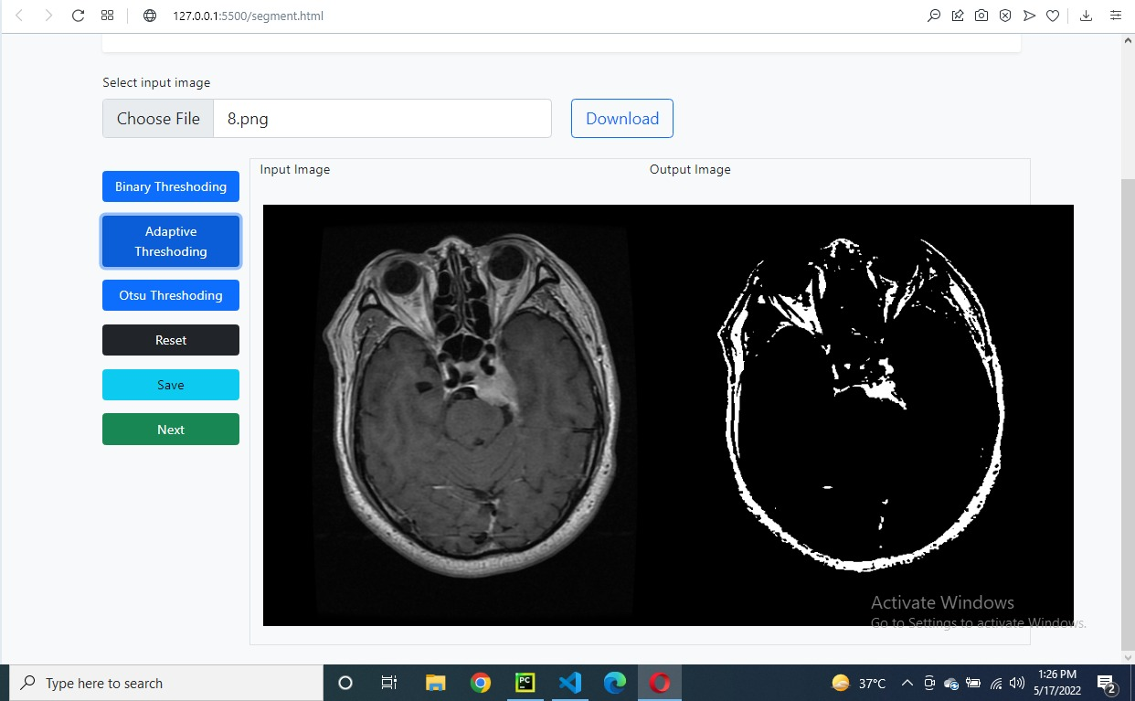
Conclusion
Enter your project title here

Slide 22
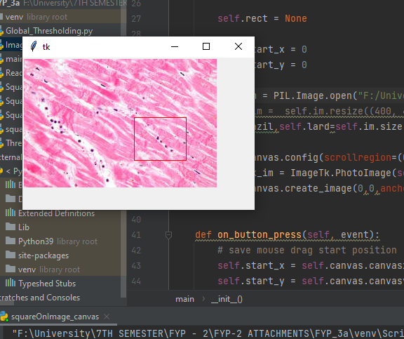
Cont.
Enter your project title here

Slide 23

Video Demo
Enter your project title here
Video 1: Flow diagram of the project

Slide 24
References
Enter your project title here
A. C. Ruifrok and D. A. Johnston, “Quantification of histochemical staining by color deconvolution,” 2001.
A. Dutta and A. Zisserman, “The VIA Annotation Software for Images, Audio and Video,” MM 2019 - Proc. 27th ACM Int. Conf. Multimed., pp. 2276–2279, Apr. 2019, doi: 10.1145/3343031.3350535.
A. Torralba, B. C. Russell, and J. Yuen, “LabelMe: Online image annotation and applications,” in Proceedings of the IEEE, 2010.
M. Aubreville, C. Bertram, R. Klopfleisch, and A. Maier, “SlideRunner: A tool for massive cell annotations in whole slide images,” in Informatik aktuell, Feb. 2018, no. 211279, pp. 309– 314, doi: 10.1007/978-3-662-56537-7_81.
M. Satyanarayanan, A. Goode, B. Gilbert, J. Harkes, and D. Jukic, “OpenSlide: A vendor-neutral software foundation for digital pathology,” J. Pathol. Inform., vol. 4, no. 1, p. 27, 2013, doi: 10.4103/2153-3539.119005.
M. Tkachenko, M. Malyuk, N. Shevchenko, A. Holmanyuk, and N. Liubimov, “Label Studio: Data labeling software,” 2020. https://github.com/heartexlabs/label-studio (accessed Oct. 09, 2020).
“microsoft/VoTT: Visual Object Tagging Tool: An electron app for building end to end Object Detection Models from Images and Videos.” https://github.com/microsoft/VoTT (accessed Oct. 09, 2020).

Slide 25


